Slide 1

Swami Keshvanand Institute of Technology,
Management & Gramothan, Jaipur
Industrial Training
“Data Analytics”
Submitted By: Submitted To:
Abhishek Pandey Dr. Sanwta Ram Dogiwal 20ESKIT004 Associate Professor
7ITA (G1)
Session 2023-24

Slide 2
Table of Content
1. | Certificate
2. | About Company
3. | What is Data Analytics?
4. | Python Libraries for Data Analytics
5. | Case Study:Analysis Of Superstore Dataset
6. | Agenda
7. | Project Overview
8. | Who are end users of this project?
9. | Solution and its Value Proposition
10. | Modeling
11. | Results
12. | References

Slide 3
Certificate

Slide 4

About Company…
EDUNET FOUNDATION
Edunet Foundation is a social enterprise which was founded in 2015 and focuses on bridging the academia-industry divide, enhancing student employability, promoting innovation and creating an entrepreneurial ecosystem in India. With the partnership of AICTE and IBM Skill Build, Edunet foundation trained thousands of brilliant minds world wide.

Slide 5
What is Data Analytics?
Data Analytics is the process of examining, cleaning, transforming, and modeling data to discover useful information, draw conclusions, and support decision-making. It involves analyzing large sets of data to uncover patterns, trends, correlations, and other insights that can help organizations make informed business decisions. Data Analytics is the field of study that combines domain expertise, programming skills, and knowledge of mathematics and statistics to extract meaningful insights from data. These insights can be used to guide decision making and strategic planning. Python programming and Machine Learning algorithms are the main pillers for Data Analytics. Data Analyst helps organizations by discovering pattern and trends in data set to extract insights. Data Analytics is used in every area covering E-commerce platforms, Healthcare, Stock exchange, Aviation control, whether forecasting and many more.

Slide 6
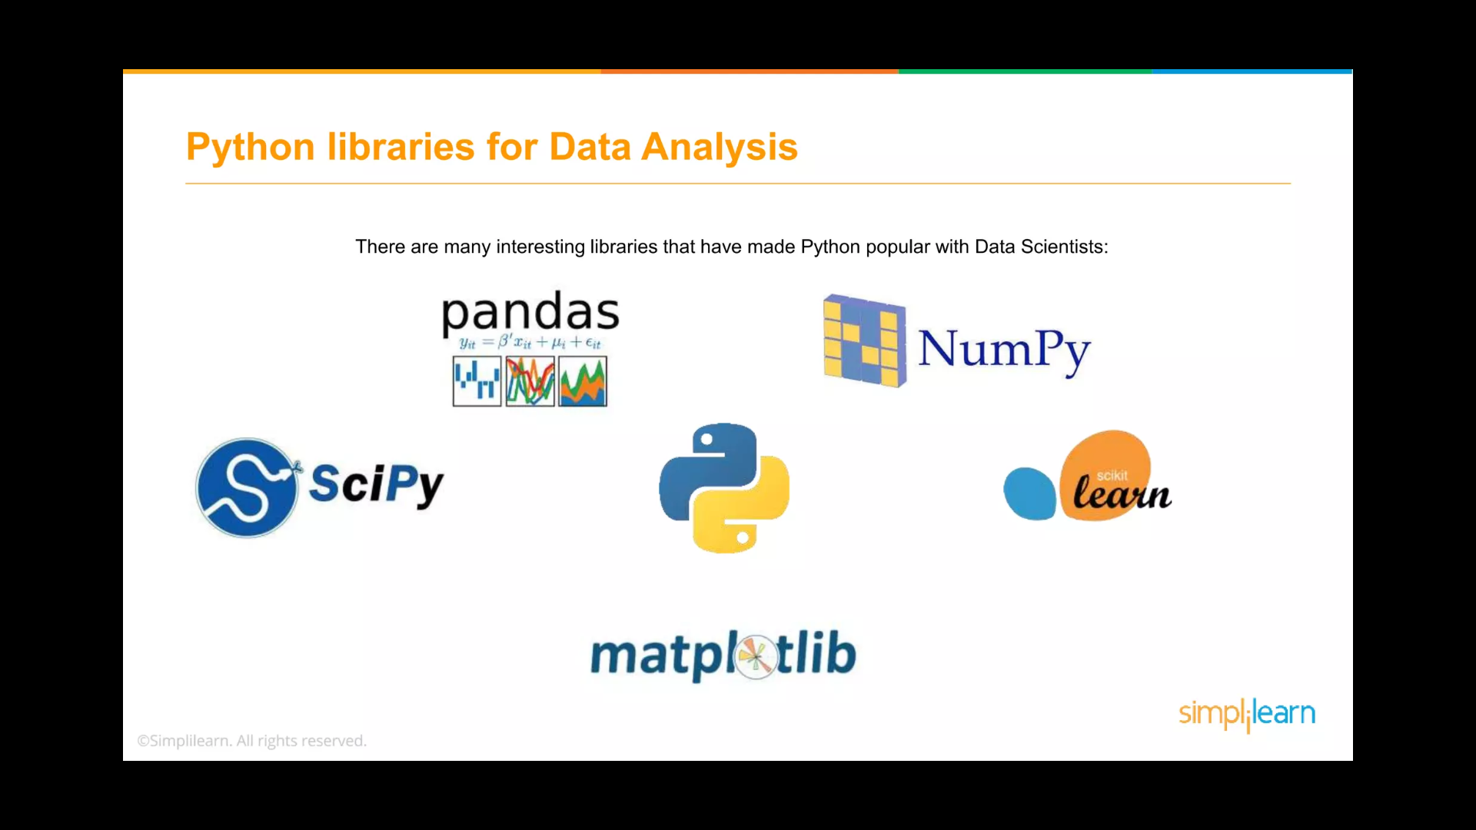


Slide 7
CASE STUDY: ANALYSIS OF SUPERSTORE
Conduct a comprehensive analysis of the superstore's sales and customer data to identify patterns, trends, and insights that can help optimize business operations and increase profitability. The primary goal is to understand the store's performance, customer behavior, and identify areas for improvement.

Slide 8
AGENDA
The agenda for the analysis of superstore data can be structured into several key steps and tasks to ensure a
thorough and comprehensive examination of the data. Here is a detailed agenda:
Data Collection and Exploration
Data Cleaning and Preprocessing
Descriptive Analytics
Sales Analysis
Customer Segmentation
Profitability Analysis
Customer Retention and Churn Analysis
Geographic Insights
Supplier Performance
Cross-Selling Opportunities

Slide 9
PROJECT OVERVIEW
1. Introduction: The analysis of superstore data project aims to conduct a comprehensive examination of the sales and customer data of a retail superstore to gain valuable insights that can enhance business operations and drive strategic decision-making. By analyzing the vast amount of data collected from various sources, the project aims to identify patterns, trends, and opportunities that can lead to improved sales, increased profitability, and better customer satisfaction.
2. Objectives:
Explore the sales data to understand the performance of different products, product categories, and store locations.
Segment customers based on their buying behavior and demographics to tailor marketing strategies.
Analyze the profitability of products and identify areas for cost optimization.
Discover seasonal patterns and trends to plan for inventory and staffing requirements.
Identify factors influencing customer churn and propose strategies for customer retention.
Evaluate supplier performance and suggest improvements in the supply chain.
Identify cross-selling opportunities to increase sales and revenue.
Assess the performance of different store locations and propose expansion or resource allocation strategies.

Slide 10
Data Collection and Exploration:
Gather relevant data from multiple sources, including sales records, customer data, inventory data, etc. Perform data exploration to understand the structure and quality of the data.
Data Cleaning and Preprocessing:
Address data quality issues, handle missing values, and remove duplicates.
Transform and reformat data as needed for analysis.
Descriptive Analytics:
Generate summary statistics and visualizations to get an overview of the data.
Sales Analysis:
Identify top-selling products, best-selling product categories, and low-performing products.
Analyze sales trends over time and across different store locations.
Customer Segmentation:
Segment customers based on their purchasing behavior, demographics, and other relevant criteria. Analyze each customer segme8. Profitability Analysis:
Calculate the profitability of products and product categories. Identify high-margin and low-margin items for pricing optimization.
9. Customer Retention and Churn Analysis:
Analyze customer churn rates and identify factors influencing customer attrition. Suggest strategies to improve customer retention and loyalty.

Slide 11
WHO ARE THE END USERS OF THIS PROJECT?
Store Managers
Marketing Team
Sales Team
Supply Chain Managers
Customer Support Team
Finance Department
Business Executives and Decision Makers
Operations Team
Data Analysts and Data Scientists

Slide 12
YOUR SOLUTION AND ITS VALUE PROPOSITION
SOLUTION:
Comprehensive Data Analysis
Data Cleaning and Preprocessing
Customer Segmentation
Sales and Profitability Analysis
Store Performance Evaluation
VALUE PROPOSITION:
Data-Driven Decisions
Increased Sales and Profitability
Improved Customer Satisfaction
Operational Efficiency
Maximized ROI

Slide 13
HOW DID YOU CUSTOMIZE THE PROJECT AND MAKE IT YOUR OWN
Data Sources: I identifed and specified the actual data sources from which the super store's data would be
collected. These could include sales databases, customer records, inventory systems, and other relevant sources.
Key Performance Indicators (KPIs): The choice of KPIs and metrics for evaluating the super store's performance would be customized to align with their specific business goals and priorities. This could include specific sales metrics, customer retention rates, or regional performance indicators.
Recommendations and Actionable Insights: The analysis would be focused on providing actionable recommendations and insights that directly address the super store's challenges and opportunities. These recommendations would be specific to the super store's context and strategic goals.
Privacy and Data Security: The customization would also involve ensuring that the data analysis adheres to any privacy and data security regulations applicable to the super store's data.

Slide 14
MODELLING
Sales Forecasting Model: This model uses historical sales data to forecast future sales. Time series forecasting techniques such as ARIMA (AutoRegressive Integrated Moving Average) or seasonal decomposition can be applied to predict sales trends, seasonality, and potential fluctuations.
Recommendation Engine: A recommendation engine suggests products or services to customers based on their past purchase history or preferences. Collaborative filtering or content-based filtering algorithms can be used to build such models.
Market Basket Analysis: Market basket analysis examines customer transactions to discover relationships between products frequently purchased together. Apriori algorithm or association rule mining can be used to find item associations.
Customer Lifetime Value (CLV) Model: CLV models estimate the value of a customer over their lifetime, helping the super store prioritize customer retention efforts and customer acquisition strategies.

Slide 15
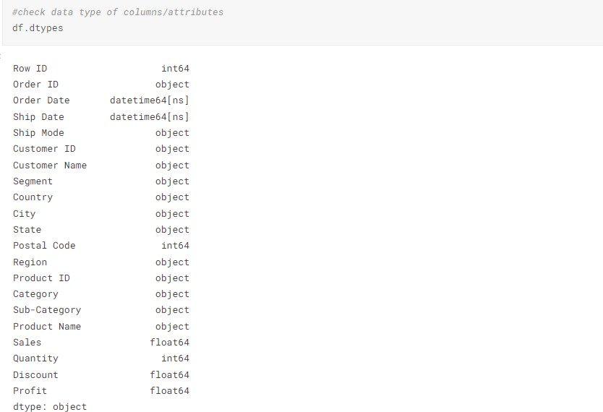
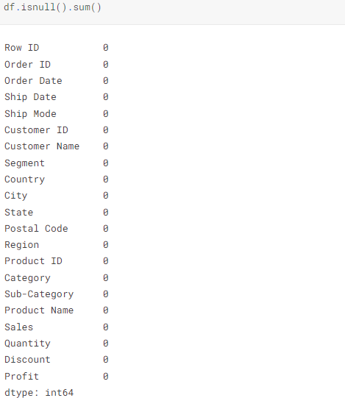
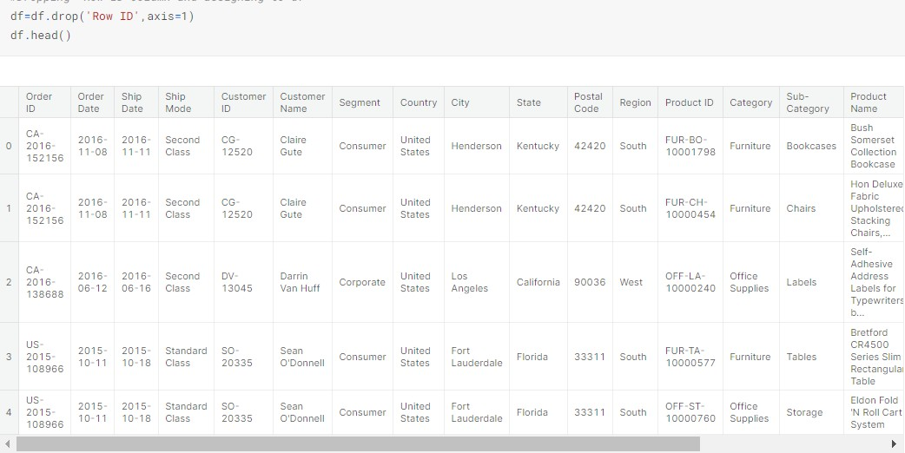
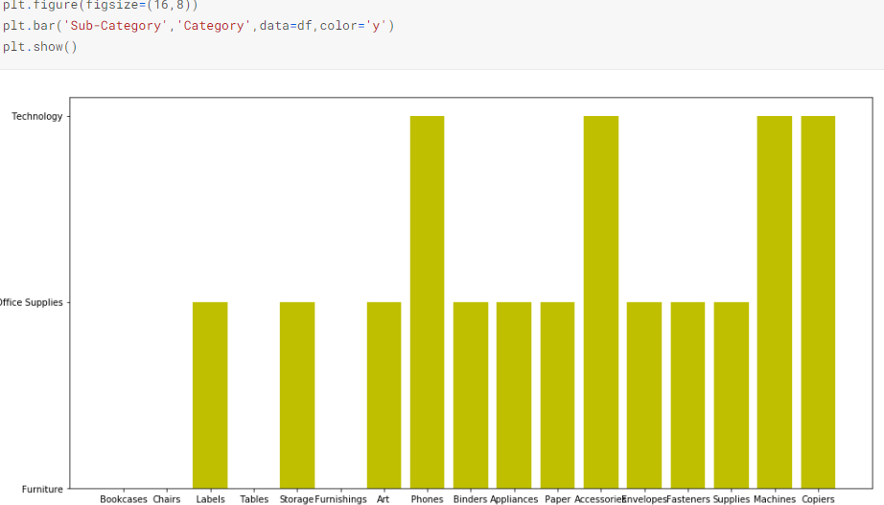
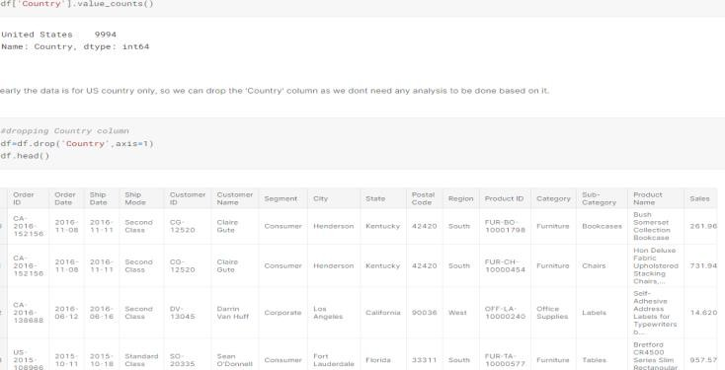
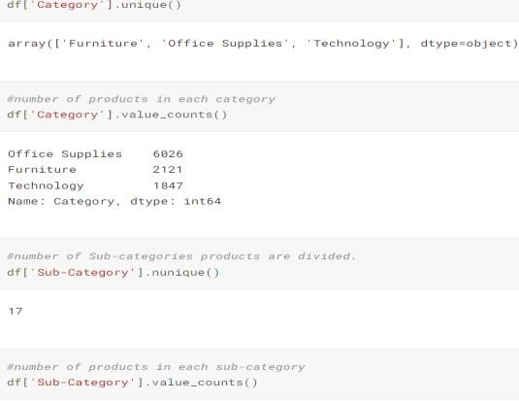
RESULTS

Slide 16
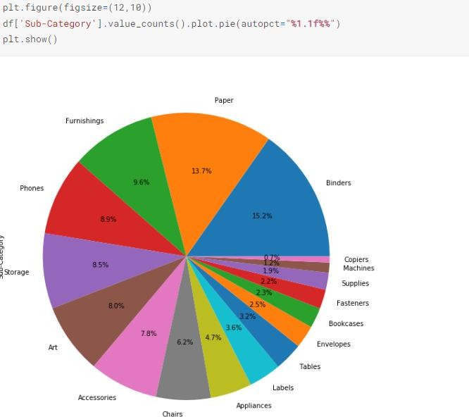
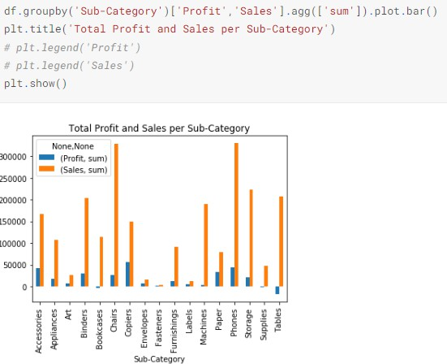
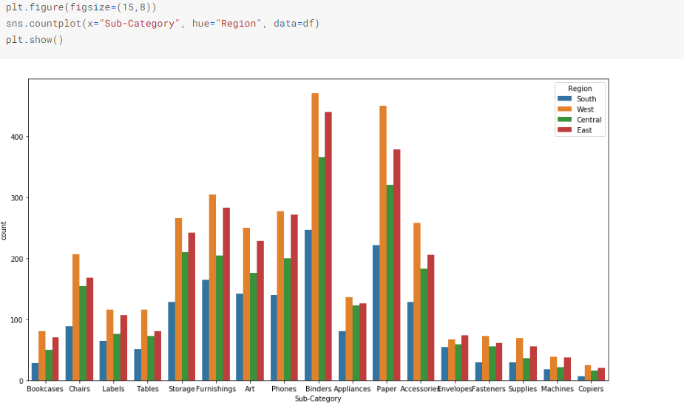
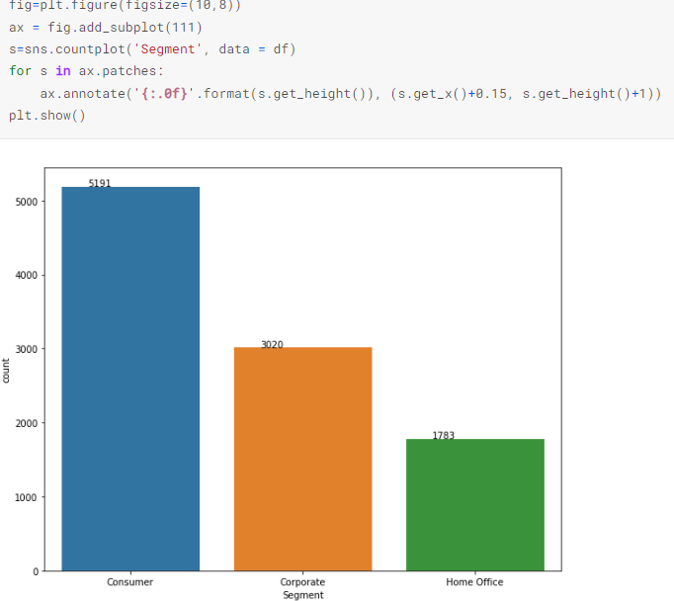
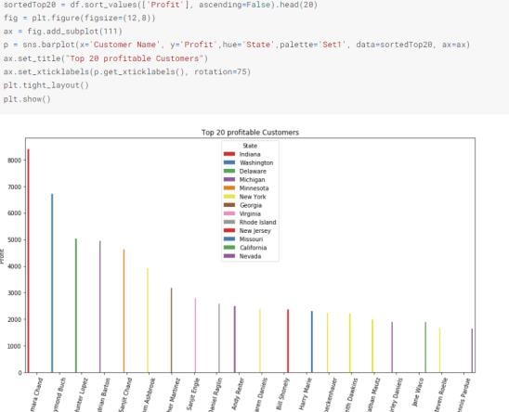

Slide 17
LINKS
https://www.kaggle.com
https://www.investopedia.com
https://skills.yourlearning.ibm.com
https://careerfoundry.com/en/blog/data-analytics
https://www.techtarget.com

